Slide 1
INTRODUCTION TO DATABASES
BY NADER FADHEL

Slide 2

MySQL
MySQL the acronym "MyStructuredQueryLanguage" is an open sources relational database management system. The use of PHP requires the presence of a database, and to manage this database one must use a database management system in separate tables and bring everything together in a single table.
This server can run several processes at the same time ie "multithreaded" and which also runs on Windows Linux Mac OS ie "multi-user".

Slide 3
MySQL
How Does MySQL work ?
MySQL creates a database for storing and manipulating data, defining the relationship of each table.
Clients can make requests by typing specific SQL statements on MySQL.
The server application will respond with the requested information and it will appear on the clients’ side.

Slide 4

PostgreSQL
PostgreSQL is a powerful, open source object-relational database system with over 30 years of active development that has earned it a strong reputation for reliability, feature robustness, and performance.
PostgreSQL server is process-based (not threaded), and uses one operating system process per database session.
PostgreSQL uses SQL for relational queries and JSON for non-relational queries.

Slide 5
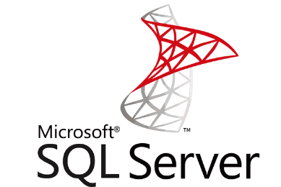
SQL SERVER
SQL Server is a relational database management system, or RDBMS, developed and marketed by Microsoft.
Similar to other RDBMS software, SQL Server is built on top of SQL, a standard programming language for interacting with the relational databases. SQL server is tied to Transact-SQL, or T-SQL, the Microsoft’s implementation of SQL that adds a set of proprietary programming constructs.
SQL Server consists of two main components:
  Database Engine
  SQLOS

Slide 6
A comparison between the three RDBMS
PostgreSQL vs. MySQL is an important decision when it comes to choosing an open-source relational database management system. Both PostgreSQL and MySQL are time-proven solutions that can compete with enterprise solutions such as Oracle and SQL Server.
MySQL has been famous for its ease of use and speed, while PostgreSQL has many more advanced features, which is the reason that PostgreSQL is often described as an open-source version of Oracle.

Slide 7
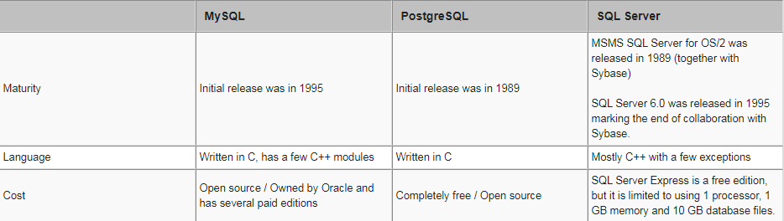
A comparison between the three RDBMS
The following table compares the features of these three RDBMS:

Slide 8
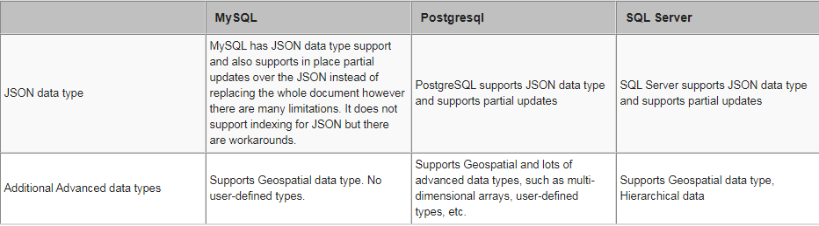
A comparison between the three RDBMS

Slide 9
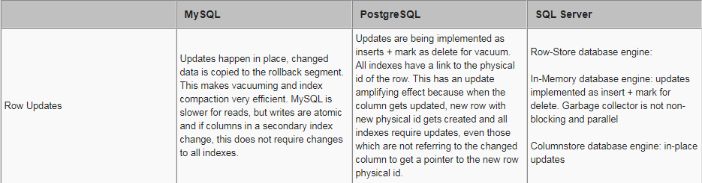
A comparison between the three RDBMS

